Slide 1
Alma Reading Room Functionality
Yoel Kortick
Senior Librarian

Slide 2

Introduction
The setup
The workflow
The workflow for “return”
Agenda

Slide 3
Introduction

Slide 4
Introduction
The Alma Reading Room functionality allows for a circulation desk to be defined as a “reading room desk”.
With this functionality the patron can request an item to be picked up at the reading room, and then the item can be used in the reading room for an extended period of time. It can be returned as “not final”.
This means that the patron can leave the items in the reading room for a predefined period of time while they remain loaned to him or her.

Slide 5
The setup

Slide 6
The setup
In our example here we have two circulation desks which function as Reading Room circulation desks:
The Thomas J. Safransky Reading Room
The General Reading Room
The actual examples here with a request, loan and return will be done using “The Thomas J. Safransky Reading Room”

Slide 7
The setup
We will access both reading rooms at “Configuration > Configuring for “Main Library” > Fulfillment > Library Management > Circulation Desks” .
The reason we chose “Main Library” is because these desks (which function as reading Rooms) are part of the Main Library.

Slide 8
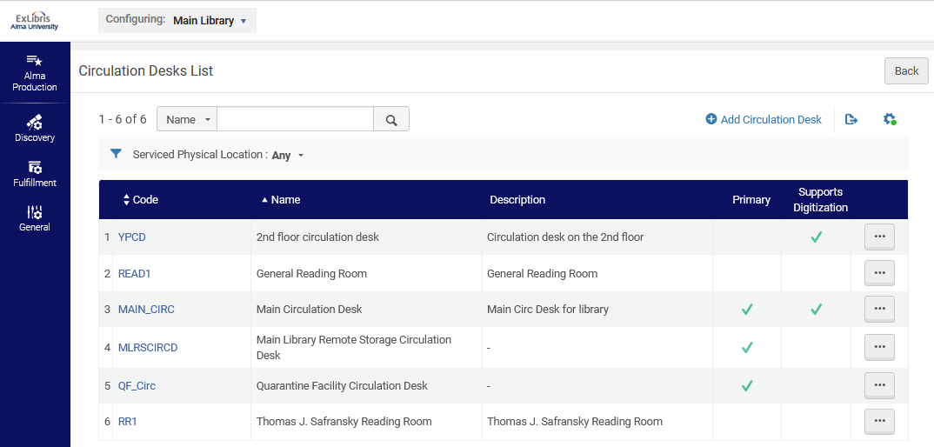
The setup

Slide 9
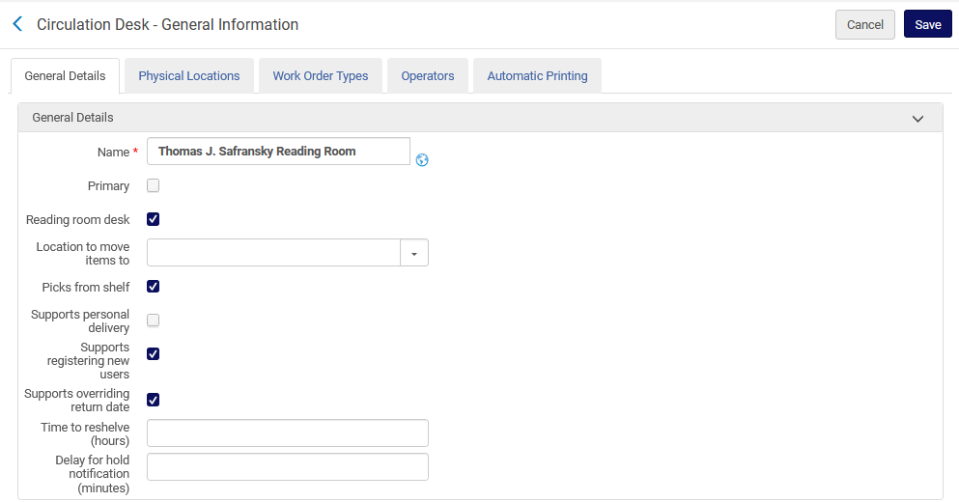
The setup - The Thomas J. Safransky Reading Room
First we will look at The Thomas J. Safransky Reading Room
This means it will function as a reading room

Slide 10
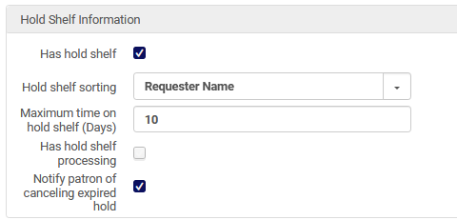
The setup - The Thomas J. Safransky Reading Room
The Reading Room needs to have a hold shelf

Slide 11
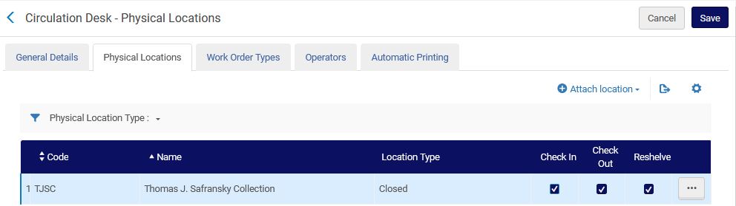
The setup - The Thomas J. Safransky Reading Room
The Thomas J. Safransky Reading Room includes one location of type closed and the location name is “Thomas J. Safransky Collection”

Slide 12
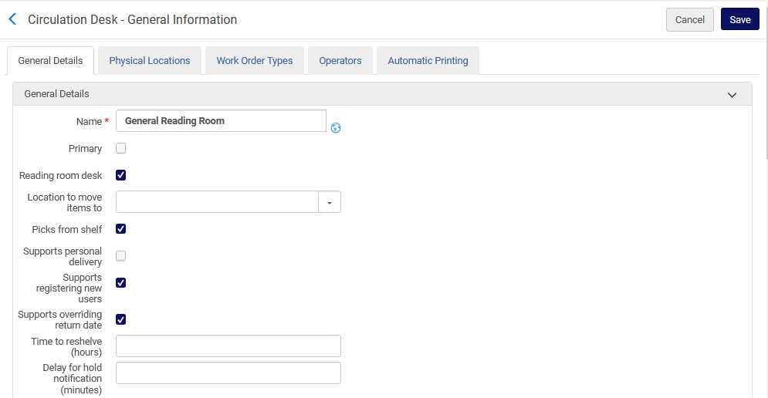
The setup – General Reading Room
Now we will look at The General Reading Room
This means it will function as a reading room

Slide 13
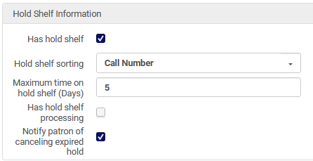
The setup – General Reading Room
The Reading Room needs to have a hold shelf

Slide 14
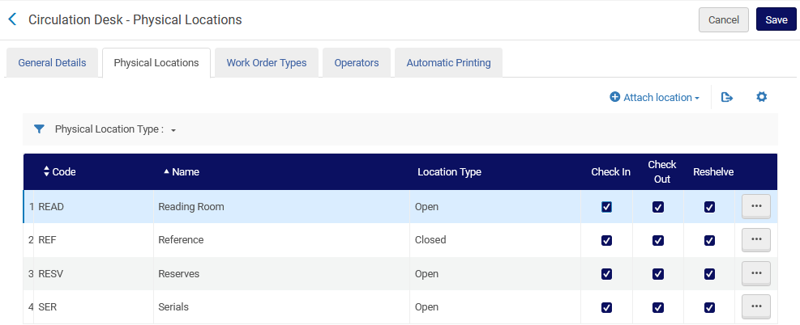
The setup – General Reading Room
The General Reading Room includes four locations and one (Location “Reference”) is of type closed

Slide 15
The setup
The location which is attributed to the first reading room desk is part of the fulfillment unit called “The Thomas J. Safransky Collection Location”
The location could also be part of a fulfillment unit with several locations.

Slide 16
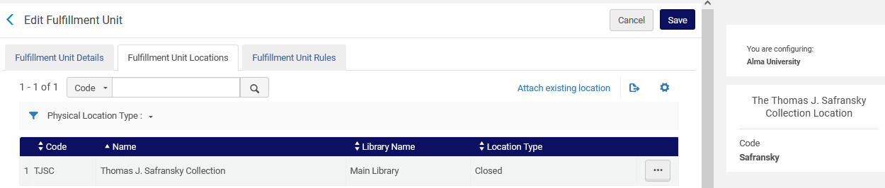
The setup
The fulfillment units are accessed at “Configuration > Configuring for Institution> Fulfillment > Physical Fulfillment > Fulfillment Units” .
This is the fulfillment unit
This is the “location”

Slide 17
The setup
A fulfillment unit rule exists for loan (see next slide)
The rule states “If the location is “Main Library - Thomas J. Safransky Collection” then use the Terms of use (TOU) “One week loan”

Slide 18
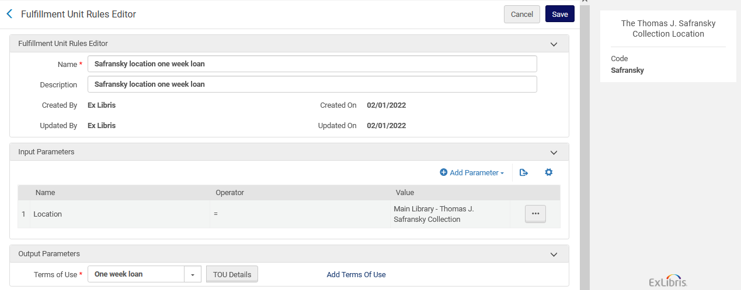
The setup

Slide 19
The setup
The Terms of Use are accessed at are accessed at “Configuration > Configuring for Institution> Fulfillment > Physical Fulfillment > Terms of Use and Policies” .
On the next slide we see the Terms of Use called “One week loan” (which we already saw is used in the loan rule for fulfillment unit “The Thomas J. Safransky Collection Location”)

Slide 20
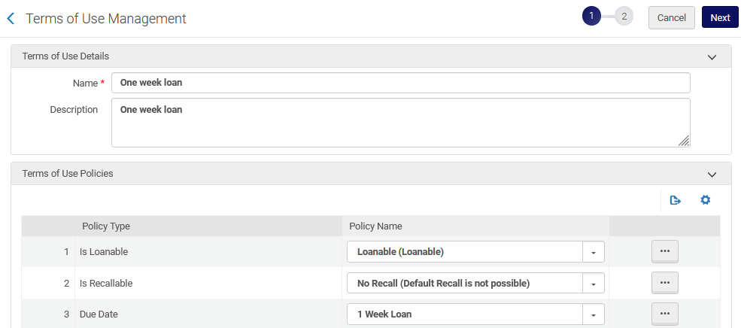
The setup

Slide 21
The setup
We have already seen the loan rule in the fulfillment unit “The Thomas J. Safransky Collection Location”.
Now we will look at the requests rule in the fulfillment unit “The Thomas J. Safransky Collection Location”.
The rule states “If the location is “Main Library - Thomas J. Safransky Collection” then use the TOU “Requestable for pickup in reading room”

Slide 22
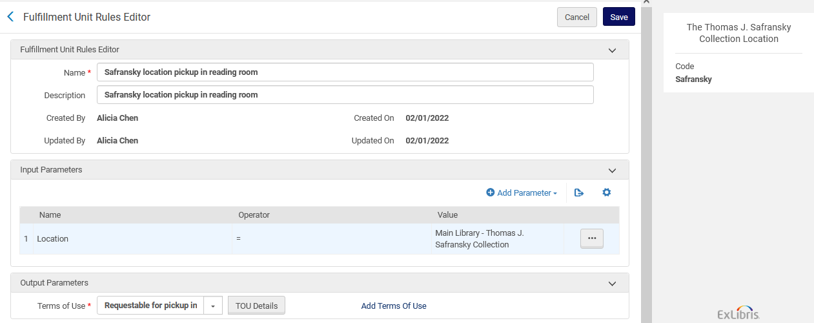
The setup

Slide 23
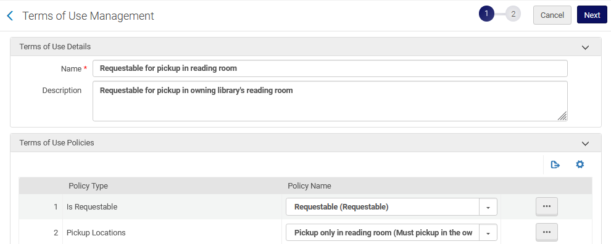
The setup
This is the TOU “Requestable for pickup in reading room”

Slide 24
The workflow

Slide 25
The workflow
An end user finds an item in Primo which is part of the “Thomas J. Safransky collection”
As previously shown, the “Thomas J. Safransky collection” is a location which is part of the circulation desk “Thomas J. Safransky Reading Room”.
This desk is defined as a Reading Room.
In the Primo GetIt tab the Patron chooses “Request”.

Slide 26
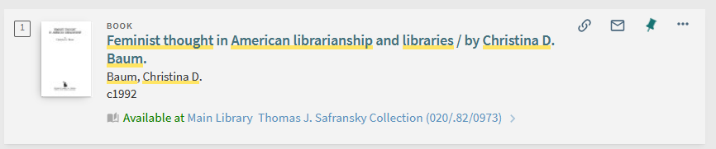
The workflow
The user will click the location

Slide 27
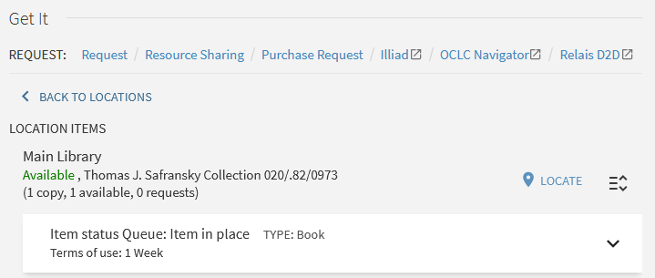
The workflow
The user will click the “request” link

Slide 28
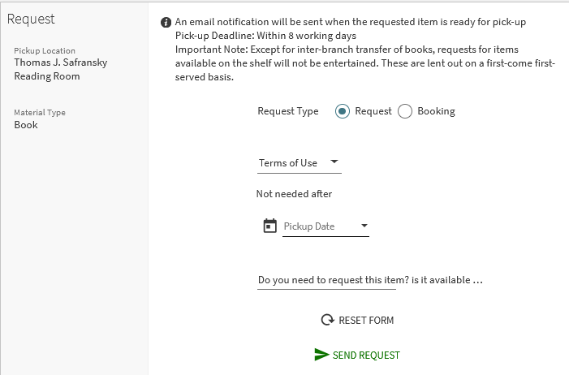
The workflow
The pickup location is the reading room

Slide 29
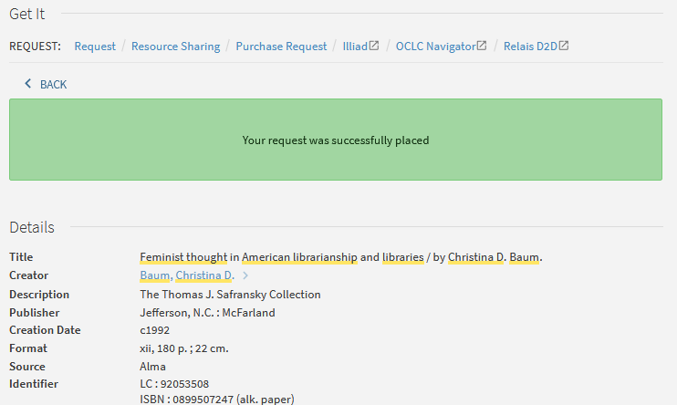
The workflow
The request is placed

Slide 30
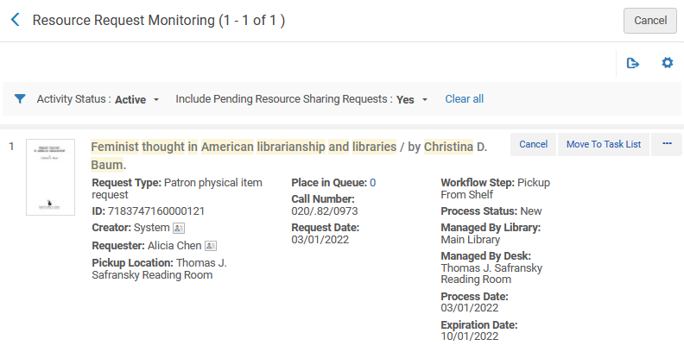
The workflow
Here is the request in the Alma user interface

Slide 31
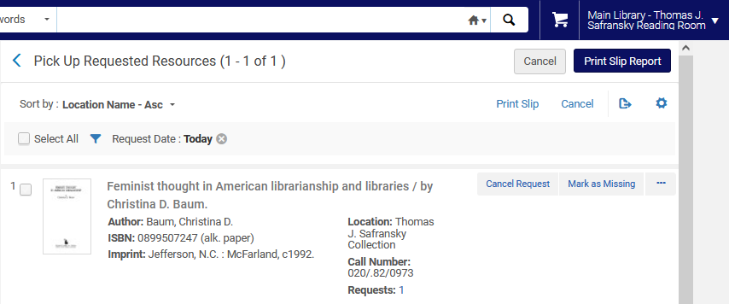
The workflow
The item appears in the “Pick from shelf list” at “Fulfillment > Resource Requests > Pick From Shelf”
At the Reading Room Circulation Desk

Slide 32

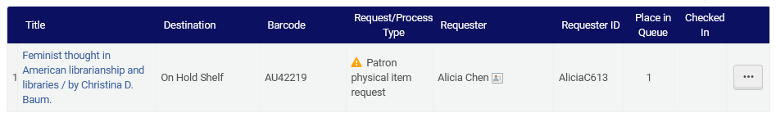
The workflow
At the reading room the staff user scans in the item and then it needs to go on the hold shelf

Slide 33
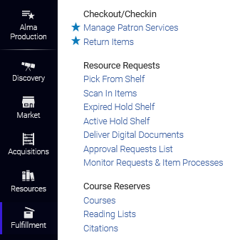
The workflow
The item will then appear in the “Waiting for Pickup” tab of the “Active Hold Shelf” of the reading room circulation desk.

Slide 34
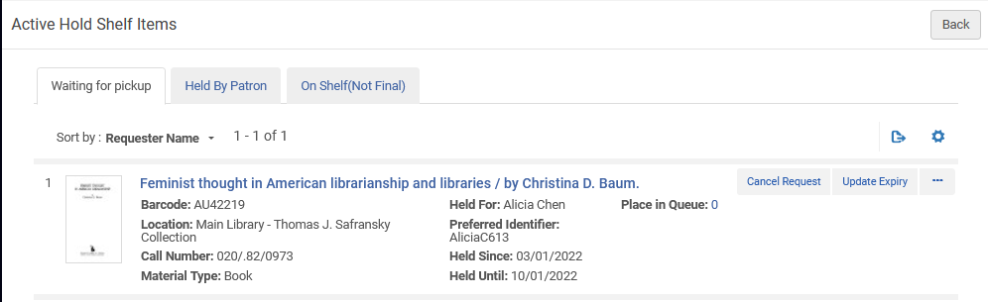
The workflow
The item will then appear in the “Waiting for Pickup” tab of the “Active Hold Shelf” of the reading room circulation desk.
More about these other two tabs later

Slide 35
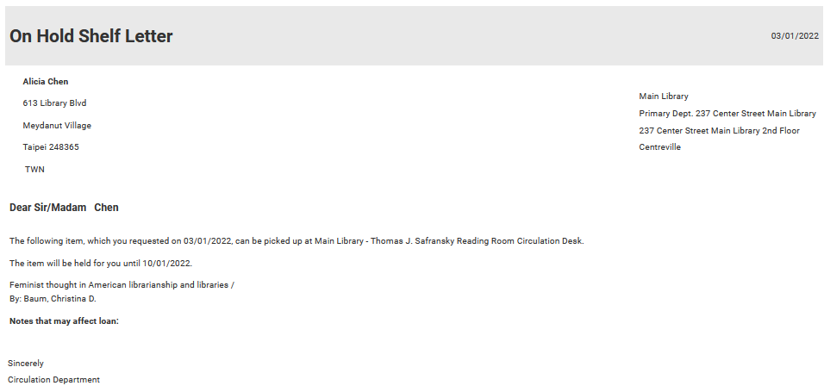
The workflow
And of course, the patron gets a letter that the item can be picked up at the reading room

Slide 36
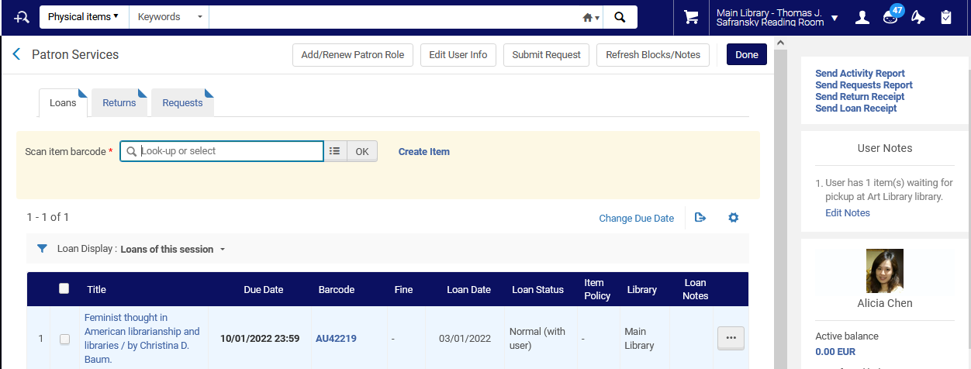
The workflow
The item is loaned to the patron at the reading room desk

Slide 37
The workflow for “return”

Slide 38
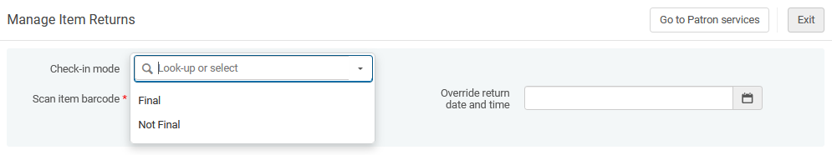
The workflow for “return”
When returning an item at a Reading Room circulation desk the following two options appear for “Check-in mode”:
Final = The patron is done with the item, it is like a regular return
Not Final = The patron wants to continue using the item but will leave it in the reading room for “later” (or tomorrow).

Slide 39

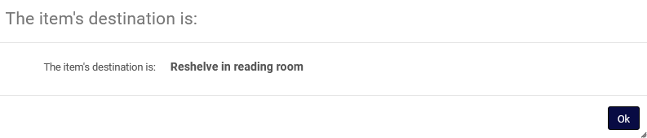
The workflow for “return”
We will return the item now as “Not Final”
The item will remain on the hold shelf (for the patron) in the reading room

Slide 40
The workflow for “return”
After returning the item as “Not Final” it will appear in the active hold shelf list in a tab “On Shelf (Not Final)”.
The name of the window here changes to ‘At reading Room Items’.
The “Held until” is the item loan due date.

Slide 41
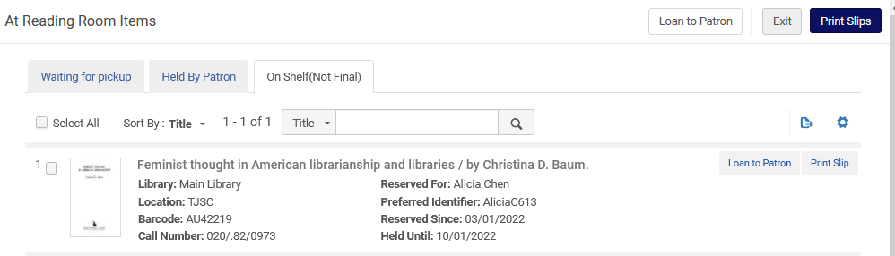
The workflow for “return”

Slide 42
The workflow for “return”
Let’s assume now the patron comes back to the Reading Room and wants to take the item again.
From the tab “On Shelf (Not Final)” we will click “Loan to patron”. The item will become loaned to the patron and appear in the tab “Held by patron” in the active hold shelf list

Slide 43

The workflow for “return”

Slide 44
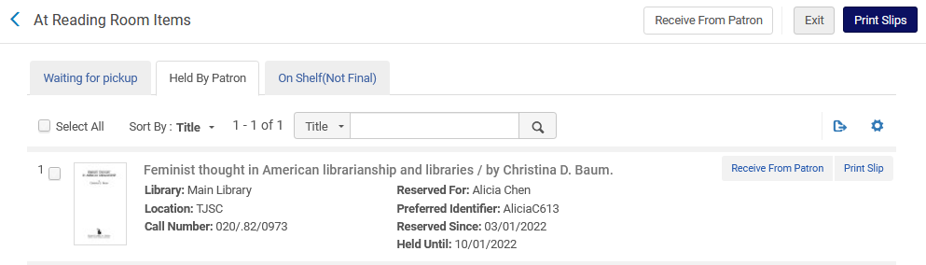
The workflow for “return”
The item is now loaned to the patron and appears as “held by patron”

Slide 45
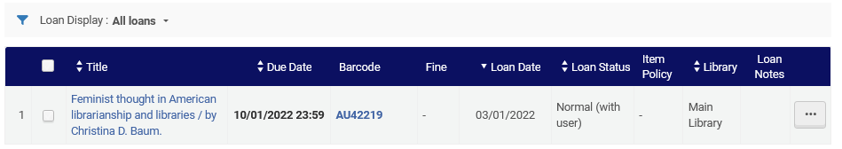
The workflow for “return”
In both situations:
When the item is in the “Held by patron” tab
When it is in the “On Shelf (Not Final)” tab
It is considered loaned to the patron.

Slide 46
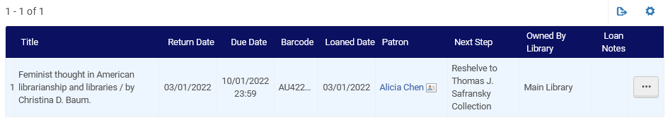
The workflow for “return”
Doing the return as “Final” returns the item as in any other “return”, and it needs to go back to wherever it is shelved.

Slide 47
xxx@exlibrisgroup.com

